Slide 1
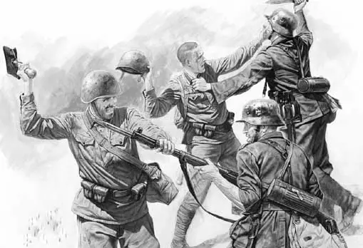
A War: A Flat View

Slide 2
A Society: An Integral View
Thinking, values, | Behaviour, individual health and education and lifestyle
Culture, language, religion, customs, stereotypes | Economic system, political system, legal system, environment

Slide 3
The Major Statement
War is AQAL
A war is an integral phenomenon
Complexity is high
Being locked in one quadrant and at one level, we miss the essence, the truth and the moral compass

Slide 4
A War: An Integral View
Thinking, values, spirituality of servicemen and civilians | Behaviour, weaponry, environment
Culture, language, religion, customs, stereotypes Imagined communities and shared dreams | Political system, economic system, legal system Propaganda, need for resources, power struggle, education & media

Slide 5
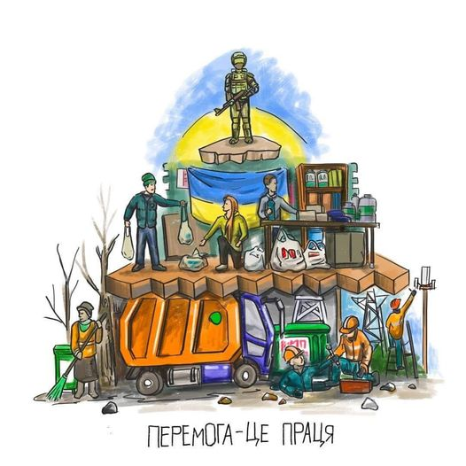

Let Us Start Asking Question
Why the 2nd most powerful army in the world is unable to win?
  A war is waged not only by armies,
  but also by states and societies

Slide 6
Ukraine and Russia
The same level/status in 1991
The cleavage after 2000
  Ukraine cures the social trauma by going forward, to modernization
  Russia cures the social trauma by going back, to resentment and revanche
Why? LL quadrant is the difference: different political cultures for centuries created conditions for emergence of different cultural codes

Slide 7
Two Vectors
Post-modern
Modern
Traditional
Ukraine
Archaic
Russia
Primitive

Slide 8
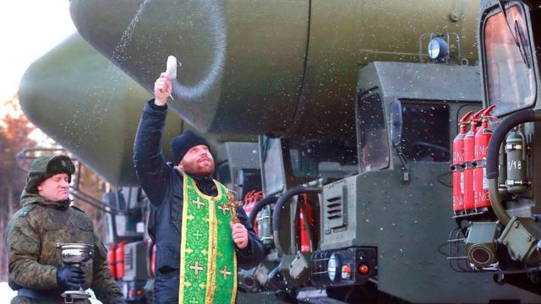
A Way to the Past: Integral Degradation
Economics: from the oligarch-feudal model of power balance to the despotic hyper-centralized system
Politics: from non-liberal democracy to an autocratic empire
Religion: from Christian
Orthodoxy to heretic
promotion of superiority
of one nation
above others
Photo: BBC

Slide 9
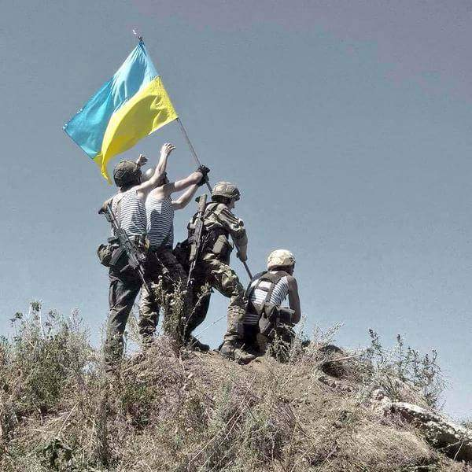
The Independence War
Ukrainian national liberation, anti-colonial, anti-imperialist revolution
  The war of independence
  always is
  a continuation of
  anti-colonial
  revolution
  The empires did not
  release anyone
  voluntarily

Slide 10
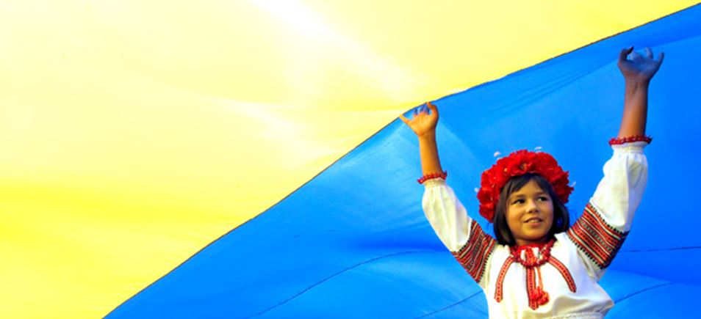
The Essence of the War
Ukraine is fighting for its future and waging a war of independence
Russia is fighting for its past, for the restoration of the empire and a seat in the club of great powers
It is impossible
to win a war for the past

Slide 11
Two Different Societies
Hierarchical and centralised society governed by an omnipotent system based on fear and subservience
vs.
Modern network society of free citizens accustomed to the values of freedom, dignity, self-sufficiency and mutual assistance
The Russian army is facing the whole Ukrainian society

Slide 12
How Modern Society Fights
A wide-scale network civil movement for army supply, rescue, assistance to IDPs
Rise of the diaspora
Guerilla war and non-violent protests in occupied territories
Volunteer information resistance movement
Enormous support for the army from local people
Dignity of local leaders
Absence of quislings
Density of “social fabric” ensures resilience

Slide 13
From Green Failure to Green Flourishing
Green understands war as conflict of two evils where good people suffer on both sides of the front line
  No matter who wins and who loses, start dialogue ASAP
  We don't care who rapes and who was raped. Just reconcile, conflict is bad
Green meme has difficulty to see a war where one party is innocent or fighting for its life, for freedom, for independence, against dictatorship
Green thinks a war always ends with peace

Slide 14
From Green Failure to Green Flourishing
Green is lost in the face of Red aggression
  Sincerely advocating for peace and harmony, Green often unwillingly nurtures it
  Mean Green Meme answers to Red aggression with peace mantra, Stockholm syndrome and the habit of powerlessness

Slide 15
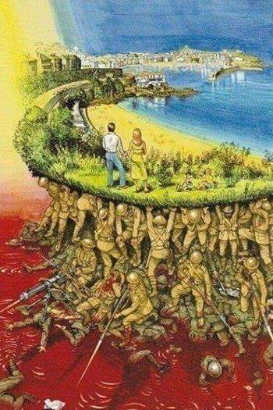
No Simple Green Option, Sorry
”We intend to remain alive.
Our neighbors want
to see us dead.
This is not a question
that leaves much room
for compromise”
(Golda Meir)

Slide 16
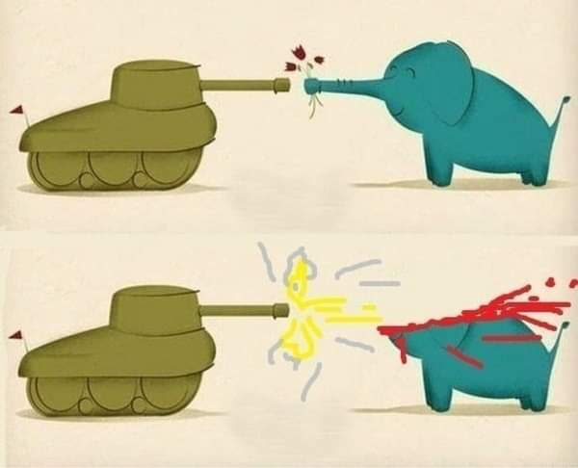
How to Respond to a Red Challenge
Red doesn’t think about long-term consequences
Red considers politeness as weakness
Red never remembers
lessons of the past
Red never negotiates
Red understands only
immediate response

Slide 17
From Green Failure to Green Flourishing
The response to Unhealthy Green is Healthy Green
  Include Red strength and resoluteness
  + Blue moral compass
  + Orange rationality and creativeness
Healthy Green is resilient, decentralized, live,
anti-fragile
We see examples in Ukraine now
  These are peak states triggered by unprecedented circumstances, rather than established mass practice
We need also Healthy Red
  We need Healthy Red because we still have Unhealthy Red to oppose

